Slide 1

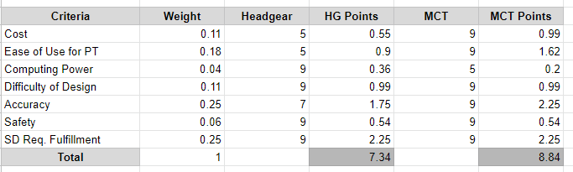
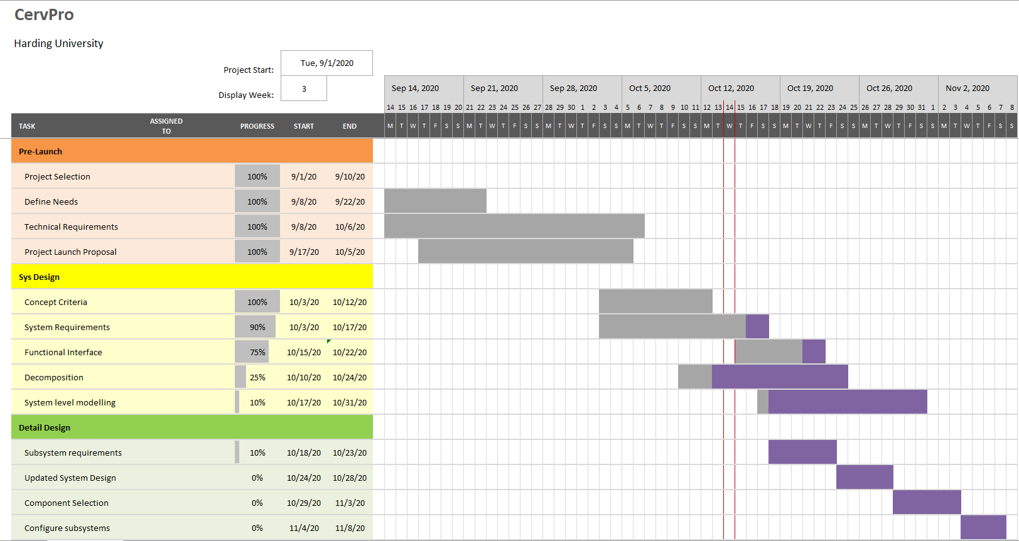

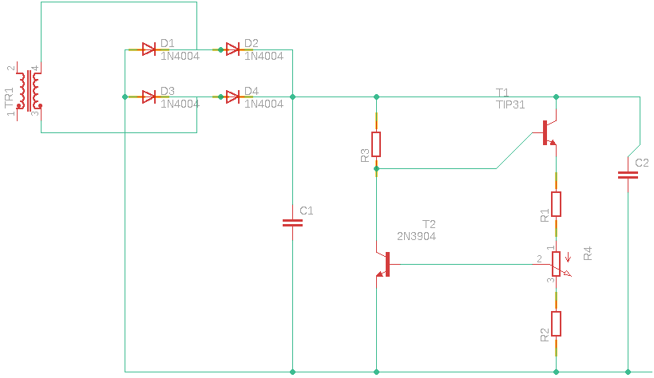
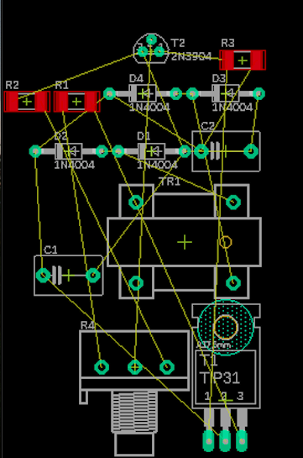
CervPro
Cervical Proprioception Diagnosis: A3 Status
Date: October 15, 2020
Members: Nathan Vielmette, Ethan Grimes, Keneth Chelelgo, and George Cook
Background
PT cervical proprioception (CP) assessments are subjective and determined by PT opinion.
Motivation is to create device that gives PTs objective data that shows patients’ ability to sense head and neck position in space.
Device will sense head position and angular velocity.
Proposed Countermeasures
Find microprocessor compatible with MoCap requirements
Investigate which standards are required and how to achieve compliance
Recent Results
Re-completed Decision Making Matrix for headgear vs. MoCap (Fig. 2)
Power supply mock-up completed (Fig. 3), (Fig. 4)
Current Conditions
Goals/Targets
Device will be user friendly
Patient will feel comfortable with device on head
Accurately measures head and position and speed
Device will be mobile and lightweight
Next Steps
Determine microprocessor compatibility with MoCap (George)
Gather information about health regulations and compliance (Keneth)
Begin functional decomposition diagram (Ethan and Nathan)
Develop internal specs for sub systems (Nathan and George)
Analysis
MoCap has specific microprocessor requirements
Health regulations for sensors and comm systems are unknown

